Slide 11
Notes:
XAMPP is exactly this
Chrome browser connecting to localhost through the Apache webserver who is talking to backend database server
We’re using HTTP but it’s looped back to itself
The webserver could also be elvis.rowan.edu
This is the full stack implementation here

Slide 14
Notes:
The role of the primary key is so that it can be used to link to another table
It has to be unique and one-of-a-kind (best way to describe is SSN → a bank only asks SSN once, then you create the user = turns into primary key)
You can create vendor_id as an automatic increment

Slide 15
Notes:
Indexing is how to retrieve the data (the machine going down one row at a time)
Relational database = relate the data from one table to another by linking them together (aka pointers) → see relations in next Terms to know slide

Slide 17
Notes:
Allows you to design so that the data you store isn’t going to be in one single database
By dividing it into multiple tables, can optimize the indexing of the data

Slide 18
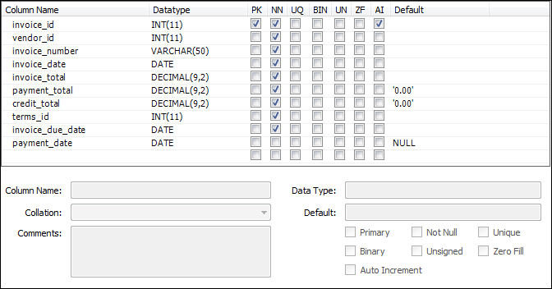

Slide 30
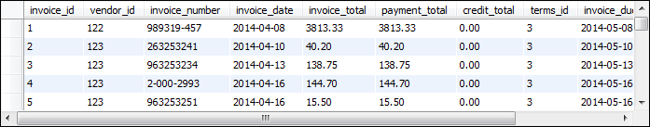

Slide 31
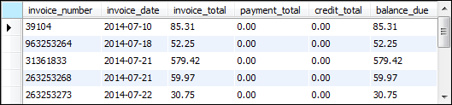

Slide 32
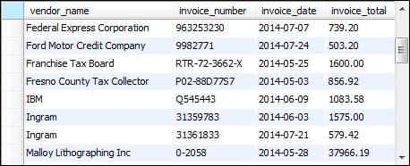

Slide 45
Notes:
Yellow code = nothing but an SQL script in actuality
To the Java code, it’s nothing but strings of characters
4 common statements in the next few statements: SELECT, INSERT, UPDATE, DELETE
SELECT = Query (pulling records out)
INSERT = Inserts entry into database
UPDATE = Changing value of an existing entry
DELETE = Deleting specific entries from a database permanently
What does this highlighted code do?
Select columns from the vendors table
Linking two tables together (with invoices) since info might be split (like merging) → matching rows with each other by vendor_id
Inner join merges both tables equivalently (more often) but outer join has a sequence factor with it when pulling data from 2 different tables
Invoice total must be >= 500 (it’ll show everyone that matched BUT)
The next condition sorts but also displays how the data looks like (how do you want to arrange the result) by certain columns (DESC = descending)

Slide 46
Notes:
Query becomes an executeQuery method as part of a connection to the database
No matter what programming language, the code must make connection to the database and send the input
Now the query goes into the database, and the result goes into rs

